Slide 1
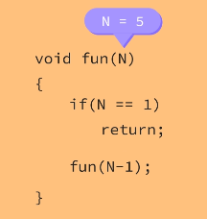
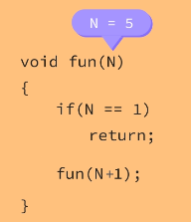
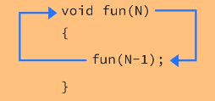
What is recursion
Recursion is the process for the function to call itself
Basic rules of recursion are
function should call itself
There should be a base case define where the function should stop calling itself
Recursive call should align towards base case in order to avoid infinite function calling.

Slide 2
How it work
Factorial using recursion
Factorial (N)= N * (N-1) * (N-2) * (N-3). . . . . . . . . .1
Recursive call : N * func(N-1)
Base case : N==1
int factorial( int n ){
if( n==1 ){
return n;
}
return n * factorial ( n-1 );
}

Slide 3
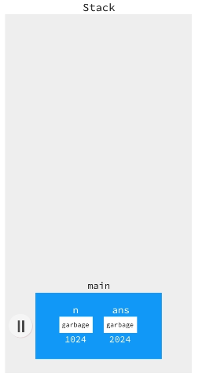

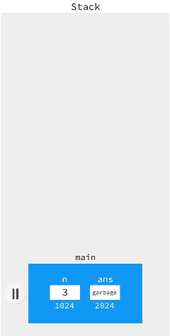
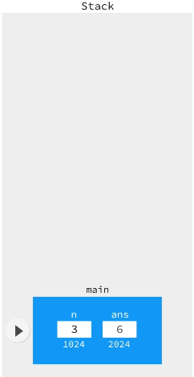
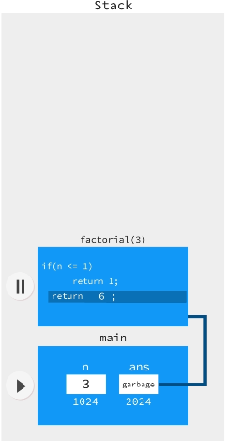
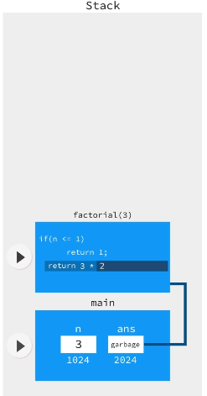
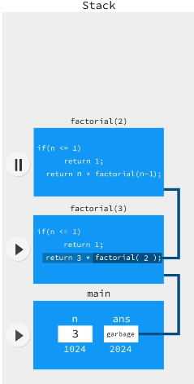
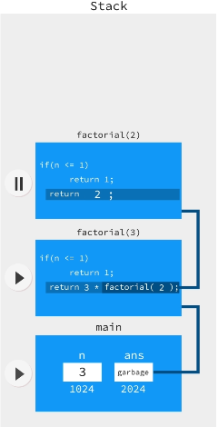
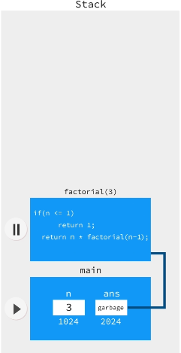
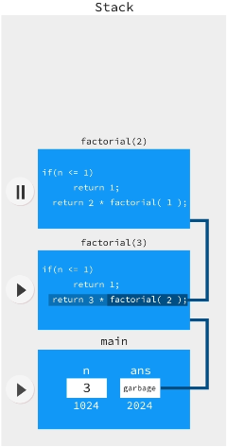
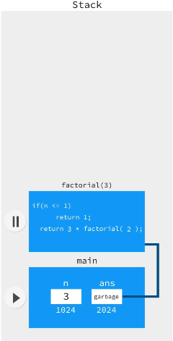
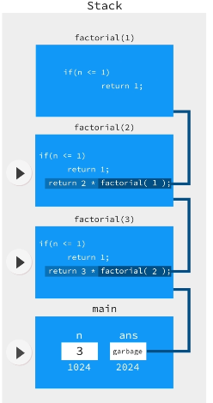
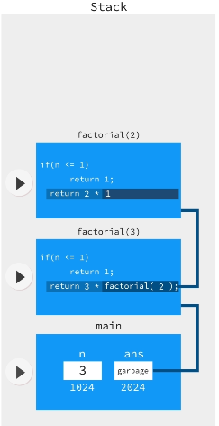
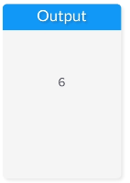
How it work
int factorial(int n) {
if (n == 1) {
return n;
}
return n * factorial(n - 1);
}
public static void main(String[] args) {
int n, ans;
n=sc.nextInt();
if (n >= 0) {
ans = factorial(n);
System.out.println(ans);
}
}

Slide 4
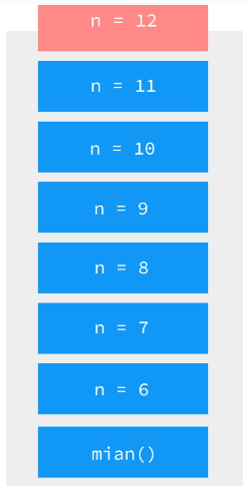
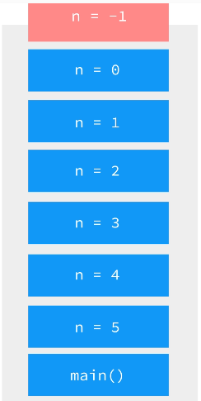
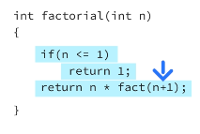

Stack Overflow
Reasons for stack overflow
Absence of Base Case
Recursive call doesn’t align towards the base case

Slide 5
Recursion and Iteration
N
N, N-1, N-2, N-3, . . . . . 1
Iteration
Recursion
void iteration(int n){
while( n > 1 ){
System.out.print( n );
n - -;
}
}
void recursion(int n){
if( n< 1 )
return ;
System.out.print( n );
recursion( - - n );
}

Slide 6

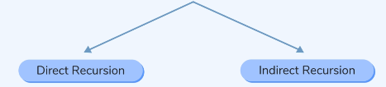
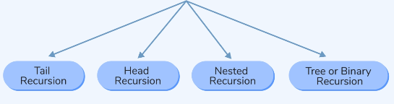
Types of Recursion

Slide 7
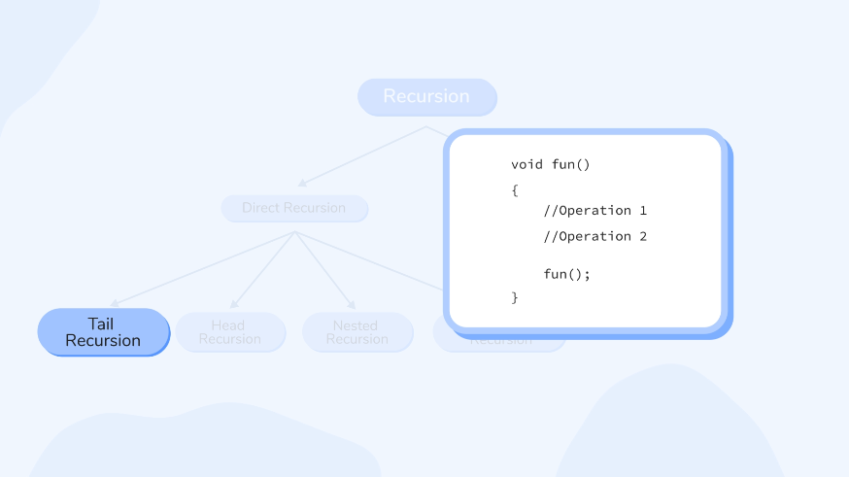
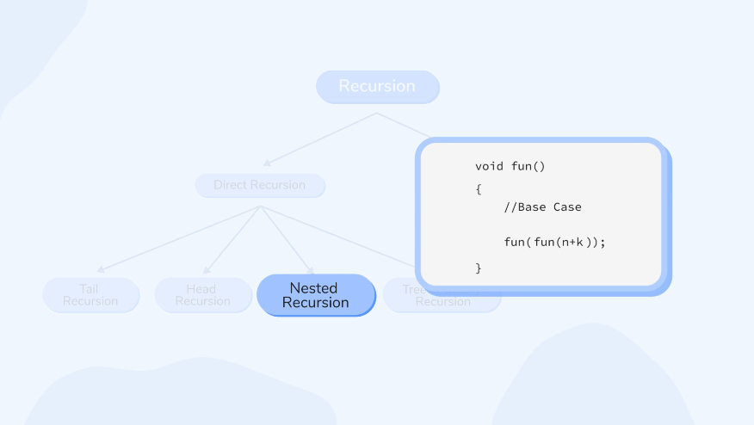
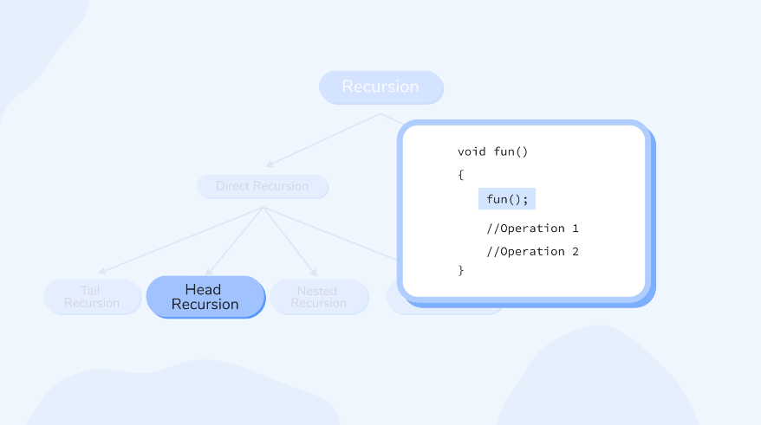
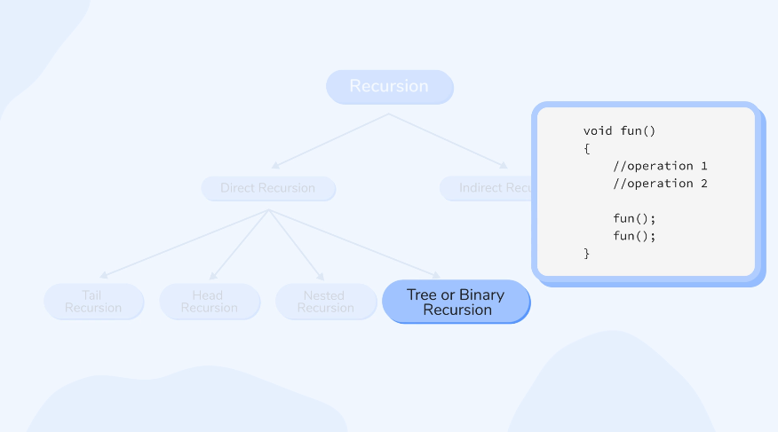
Types of Recursion

Slide 8


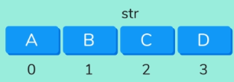






Tail Recursion
void tailRecursion(String str){
if(str.length()==0)
return;
System.out.print(str.charAt(0));
tailRecursion(str.substring(1));
}
void tailRecursion(String str){
if(str.length()==0)
return;
System.out.print(str.charAt(0));
tailRecursion(str.substring(1));
}
void tailRecursion(String str){
if(str.length()==0)
return;
System.out.print(str.charAt(0));
tailRecursion(str.substring(1));
}
void tailRecursion(String str){
if(str.length()==0)
return;
System.out.print(str.charAt(0));
tailRecursion(str.substring(1));
}
void tailRecursion(String str){
if(str.length()==0)
return;
System.out.print(str.charAt(0));
tailRecursion(str.substring(1));
}

Slide 9
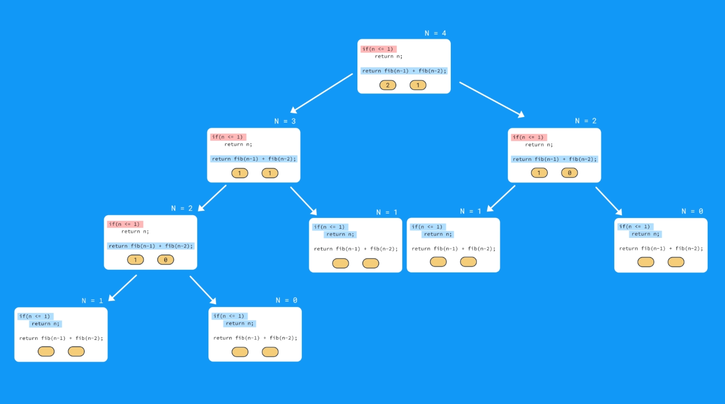
Binary or Tree
Recursion

Slide 10
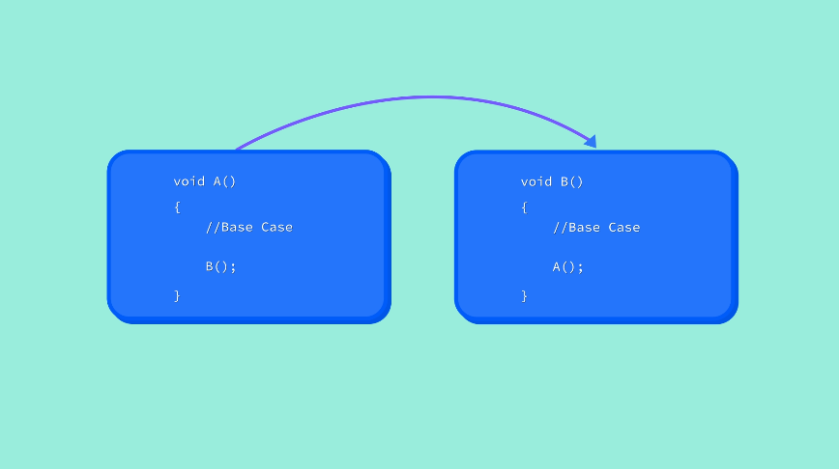
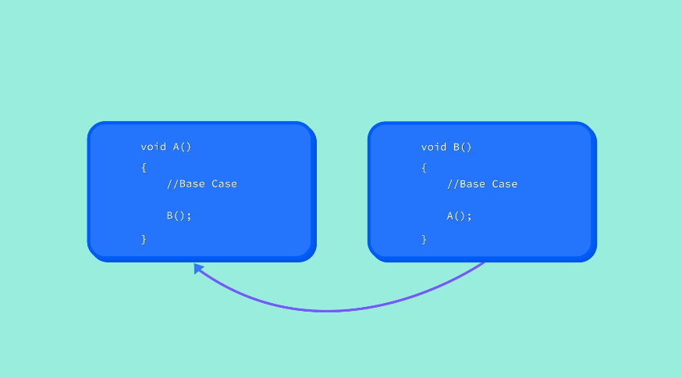
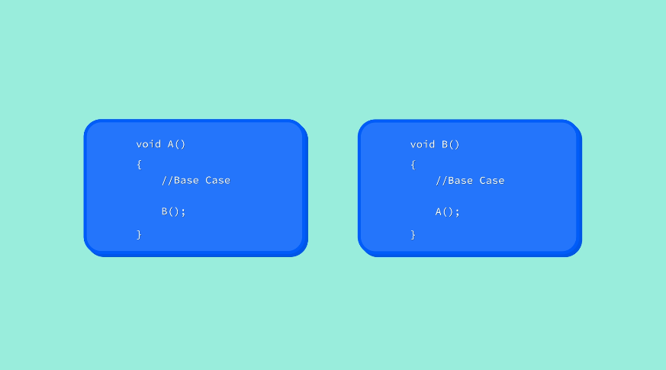
Indirect Recursion

Slide 11
Optimization of Tail Recursion
Optimization
void show(int n){
If(n<1)
return;
System.out.println(n);
show(--n);
}
void show(int n){
START:
If(n<1)
return;
System.out.println(n);
n=n-1;
goto START;
}

Slide 12
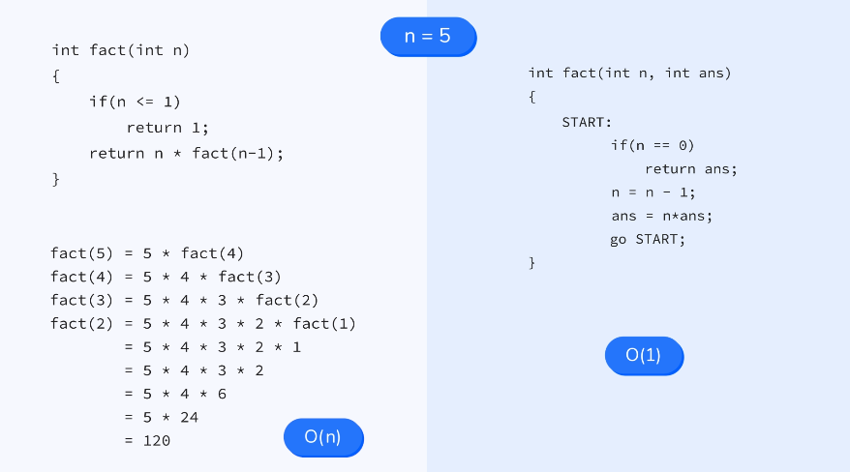
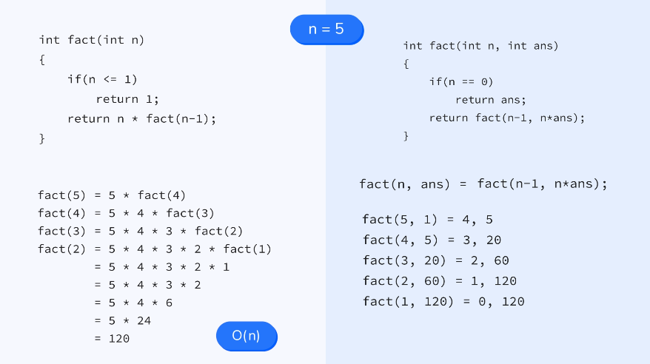
Why Tail Recursion is efficient

